Slide 1
CSCE430/830 Computer Architecture
Review of Memory Hierarchy
Lecturer: Prof. Hong Jiang
Courtesy of Yifeng Zhu (U. Maine)
Fall, 2006
Portions of these slides are derived from:
Dave Patterson © UCB

Slide 2
Memory Hierarchy - the Big Picture
Problem: memory is too slow and too small
Solution: memory hierarchy
Processor
Secondary
Storage
(Disk)
Control
Main
Memory
(DRAM)
L2
Off-Chip
Cache
L1 On-Chip
Cache
Datapath
Registers
Speed (ns):
0.25-0.5
0.5-25
80-250
5,000,000 (5ms)
Size (bytes):
<1K
<16M
<16G
>100G

Slide 3
Fundamental Cache Questions
Q1: Where can a block be placed in the upper level?
(Block placement)
Q2: How is a block found if it is in the upper level?
(Block identification)
Q3: Which block should be replaced on a miss?
(Block replacement)
Q4: What happens on a write?
(Write strategy)

Slide 4
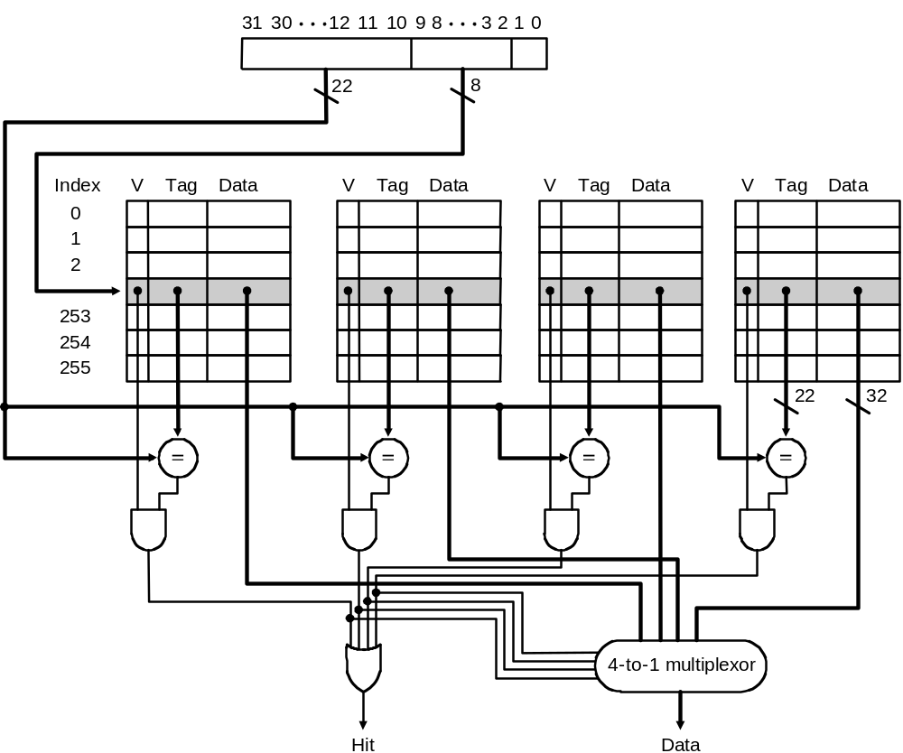
Set Associative Cache Design
Key idea:
  Divide cache into sets
  Allow block anywhere in a set
Advantages:
  Better hit rate
Disadvantage:
  More tag bits
  More hardware
  Higher access time
A Four-Way Set-Associative Cache

Slide 5
Cache Performance Measures
Hit rate: fraction found in the cache
  So high that we usually talk about Miss rate = 1 - Hit Rate
Hit time: time to access the cache
Miss penalty: time to replace a block from lower level, including time to replace in CPU
  access time: time to acccess lower level
  transfer time: time to transfer block
Average memory-access time (AMAT)
= Hit time + Miss rate x Miss penalty (ns or clocks)

Slide 6
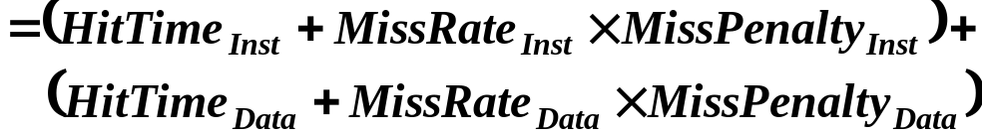
Cache performance
Miss-oriented Approach to Memory Access:
  CPI_{Execution} includes ALU and Memory instructions
Separating out Memory component entirely
  AMAT = Average Memory Access Time
  CPI_{ALUOps} does not include memory instructions

Slide 7
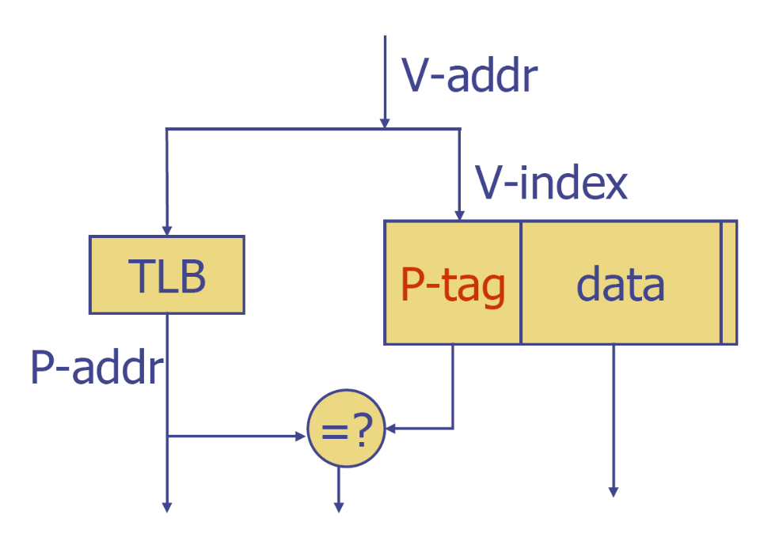
Virtually Indexed, Physically Tagged Cache
What motivation?
Fast cache hit by parallel TLB access
No virtual cache shortcomings
How could it be correct?
Require cache way size <= page size; now physical index is from page offset
Then virtual and physical indices are identical ⇒ works like a physically indexed cache!

Slide 8
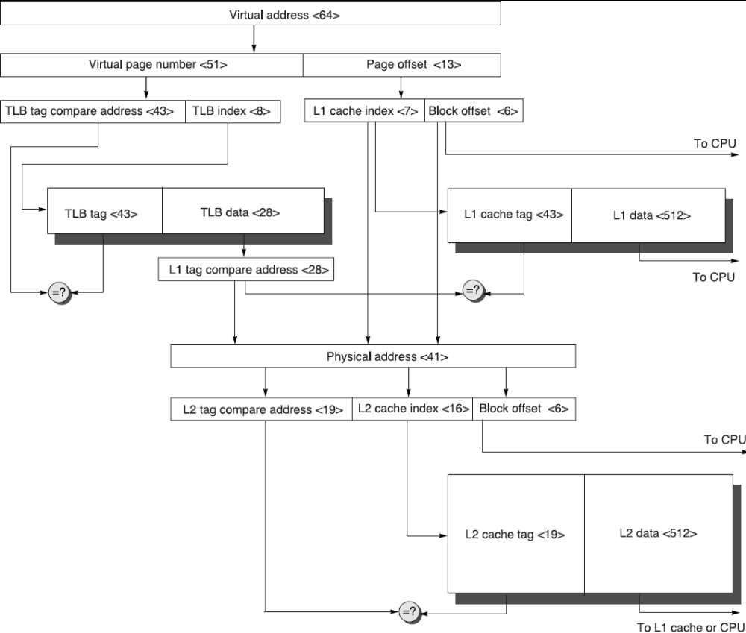
Virtually Indexed, Physically Tagged Cache
28

Slide 9
Disk Device Performance
Outer
Track
Inner
Track
Sector
Head
Arm
Controller
Spindle
Platter
Actuator
Disk Latency = Seek Time + Rotation Time + Transfer Time + Controller Overhead
Seek Time? depends no. tracks move arm, seek speed of disk
Rotation Time? depends on speed disk rotates, how far sector is from head
Transfer Time? depends on data rate (bandwidth) of disk (bit density), size of request

